Slide 1
Structuri Repetitive si Conditionale
Tipul de date enum (enumerație – pereche cheie text-valoare numerică)
While, For, transmiterea datelor de la o iteratie la alta
Case Structure – functia de IF/ELSE sau de SWITCH
Slideuri preluate din trainingurile oficiale NI disponibile pe ni.com/upb

Slide 2
D. While Loops (RECAPITULARE)
Iteration and Conditional Terminals
Tunnels
Error Checking

Slide 3
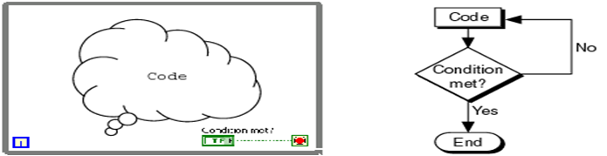
While Loops
Repeat (code);
Until Condition met;
End;
LabVIEW While Loop Flowchart Pseudo Code
Notes:
Demonstrate the creation of a While Loop.
To create a While Loop complete the following:
Select the While Loop from the palette.
Use the cursor to drag a selection rectangle around the section of the block diagram you want to repeat.
When you release the mouse button, a While Loop boundary encloses the section you selected.
Add block diagram objects to the While Loop by dragging and dropping them inside the While Loop.

Slide 4
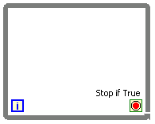
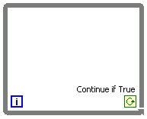
While Loops
Iteration terminal
Returns number of times loop has executed.
Is zero-indexed.
Conditional terminal
Defines when the loop stops.
Has two options.
Stop if True
Continue if True
Iteration Terminal
Conditional Terminal
Notes:
By default the iteration terminal is in lower right corner of the While Loop and the conditional terminal is in the lower left corner.
The conditional terminal defaults to Stop if True. However, you can also modify it to use Continue if True. Most applications use Stop if True.

Slide 5
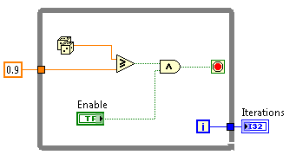
While Loops – Tunnels
Tunnels transfer data into and out of structures.
Data pass out of a loop after the loop terminates.
When a tunnel passes data into a loop, the loop executes only after data arrive at the tunnel.

Slide 6
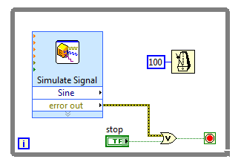
While Loops – Error Checking and Error Handling
Use an error cluster in a While Loop to stop the While Loop if an error occurs.

Slide 7
E. For Loops
Conditional Terminal
Comparison with While Loops
Numeric Conversion for Count Terminal

Slide 8
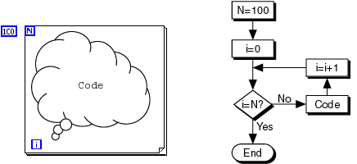
For Loops
N=100;
i=0;
Until i=N:
Repeat (code;i=i+1);
End;
LabVIEW For Loop Flowchart Pseudo Code

Slide 9
For Loops
Create a For Loop the same way you create a While Loop.
You can replace a While Loop with a For Loop by right-clicking the border of the While Loop and selecting Replace with For Loop from the shortcut menu.
The value in the count terminal (an input terminal) indicates how many times to repeat the subdiagram in the For Loop.

Slide 10
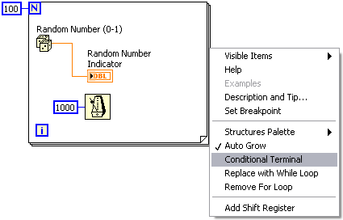
For Loops – Conditional Terminal
You can add a conditional terminal to configure a For Loop to stop when a Boolean condition is true or an error occurs.

Slide 11
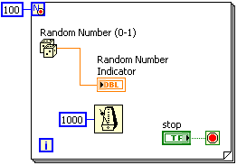
For Loops – Conditional Terminal
For Loops configured with a conditional terminal have:
A red glyph next to the count terminal.
A conditional terminal in the lower right corner

Slide 12
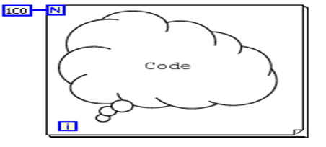
For Loop/While Loop Comparison
For Loop
Executes a set number of times unless a conditional terminal is added.
Can execute zero times.
Tunnels automatically output an array of data.
While Loop
Stops executing only if the value at the conditional terminal meets the condition.
Must execute at least once.
Tunnels automatically output the last value.

Slide 13
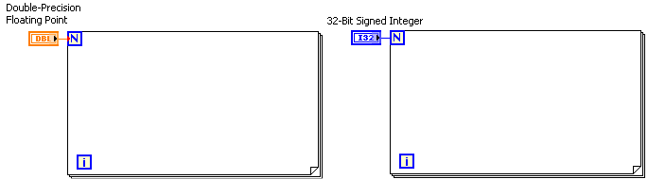
For Loops – Numeric Conversion
The number of iterations a For Loop executes must be specified in non-negative integers.
If you wire a double-precision, floating-point numeric value to the count terminal, LabVIEW converts the numeric value to a 32-bit signed integer.
Notes:
The For Loop count terminal always coerces to a 32-bit signed integer.
Typically, LabVIEW coerces numerics to the format with more bit representation. However, the For Loop count terminal works in the opposite manner. If you wire a double-precision, floating-point numeric value to the 32-bit count terminal, LabVIEW coerces the larger numeric value to a 32-bit signed integer. Although the conversion is contrary to normal conversion standards, it is necessary, because a For Loop can only execute an integer number of times. The For Loop count terminal will always coerce to a 32-bit signed integer data type.

Slide 14
Trimiterea datelor de la o iterație la alta

Slide 15
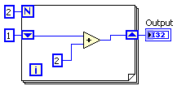
Data Feedback in Loops
When programming with loops, you often need to know the values of data from previous iterations of the loop.
Shift registers transfer values from one loop iteration to the next.
Notes:
Cover mechanics of using shift registers in later slides; here just talk about why you need them.

Slide 16
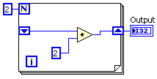
Initializing Shift Registers
Run once
VI finishes
Run again
Block Diagram | 1st run | 2nd run
Initialized Shift Register | Output = 5 | Output = 5
Not Initialized Shift Register | Output = 4 | Output = 8

Slide 17
Use Default if Unwired
Default values vary by data type:
Uninitialized shift registers use default values for first run.
Data Type | Default Value
Numeric | 0
Boolean | FALSE
String | Empty

Slide 18
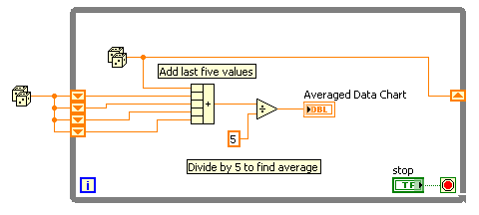
Multiple Previous Iterations
Stacked shift registers remember values from multiple previous iterations and carry those values to the next iterations.
Right-click the left shift register and select Add Element from the shortcut menu to stack a shift register.

Slide 19
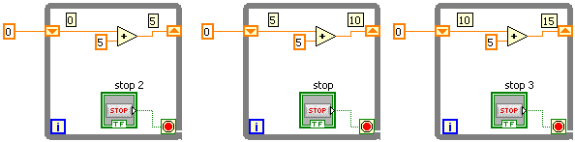
Shift Registers in action
Value 15
Initial
Value
Before Loop
Begins
First
Iteration
Second
Iteration
Last
Iteration
Notes:
In the example on this slide, an input of 0 would result in an output of 5 for the first iteration, 10 for the second iteration, and 15 for the third iteration. Shift registers are valuable for many applications that have memory or feedback between states.
Introduction to LabVIEW Hands-On 83 ni.com

Slide 20
Structuri conditionale

Slide 21
I. Case Structures
Parts of a Case Structure
Enum Case Structures
Error Case Structures
Input and Output Tunnels

Slide 22
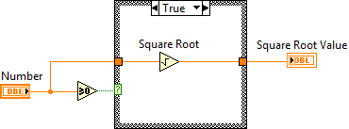
Case Structures
Have two or more subdiagrams or cases.
Use an input value to determine which case to execute.
Execute and display only one case at a time.
Are similar to case statements or if...then...else statements in text-based programming languages.

Slide 23
Case Structures
Case Selector Label
Contains the name of the current case.
Has decrement and increment arrows.
Selector Terminal
Lets you wire an input value, or selector, to determine which case executes.
Case Selector Label
Selector Terminal

Slide 24
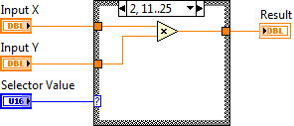
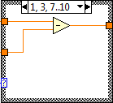
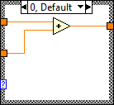
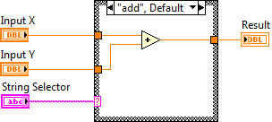
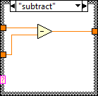
Case Structures
Selector terminal data types:
Boolean
True case and False Case
Error Cluster
Error Case and No Error Case
Integer, string, or enum
Structure can have any number of cases.
Include a Default diagram to avoid listing every possible input value.
Notes:
Boolean input to the selector terminal creates two cases: True and False
Integer or string input to the selector terminal creates multiple cases.
- Developer must add a case for each integer or string as necessary.
- If an undefined integer or strings is wired to the terminal, LabVIEW uses the Default case.
Enums
- Gives users a list of items from which to select a case.
- The case selector displays a case for each item in the enumerated type control.

Slide 25
Abstractizarea cazului
Pentru abstractizarea datelor poate fi folosit tipul de date ENUM
Enum data type defineste in realitate un tip de date caracterizat printr-o enumerație de nume(text). Fiecarui nume ii corespunde o valoare. Astfel, in loc sa folosim un integer pentru a selecta cazul, putem folosi un Enum

Slide 26
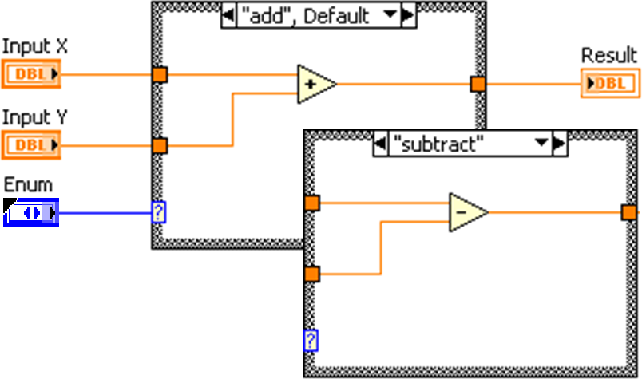
Enum Case Structure
Gives users a list of items from which to select
The case selector displays a case for each item in the enumerated type control

Slide 27
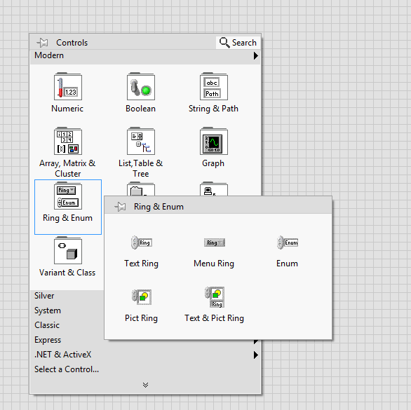
Adaugarea unui Enum
Enum-ul poate fi adaugat ca element tip control, indicator sau constanta(doar in block diagram)
Exemplu utilizare: https://youtu.be/tImN4C03W1k (pana la case structure)

Slide 28
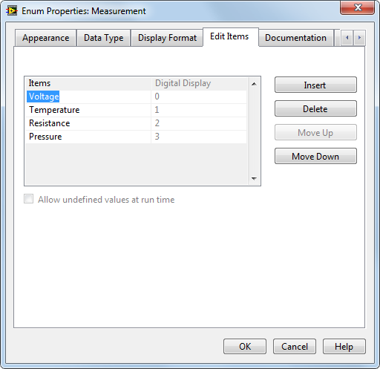

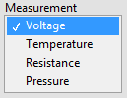

Enums
Enums give users a list of items from which to select.
Each item represents a pair of values.
String
16-bit Integer
Notes:
Enums are useful because they make strings equivalent to numbers, and it is easier to manipulate numbers than strings on the block diagram.
Point out that the data type of the enum terminal is blue, showing that the enum is passing an integer value.

